Slide 1
Welcome to React the Definitive Beginner’s Guide
Rami Sayar
Jeremy Foster

Slide 2
Agenda - list all main modules
1
Welcome to React – the Definitive Beginner’s Guide
2
Introduction to Components
3
Handling Data and State with React
4
More React with Routers and Other Add-ons
5
ES2015 with React, Webpack, and Other Tools
6
Connecting Pizza Box App with the Backend

Slide 3
Module 5: ES2015 with React, Webpack, and Other Tools
Rami Sayar
Jeremy Foster

Slide 4
What is ES2015, and what are the new JavaScript features?

Slide 5

Compiling ES6 with Babel

Slide 6
Using ES6 modules and extending React classes

Slide 7
Updating our bot app to use ES6

Slide 8
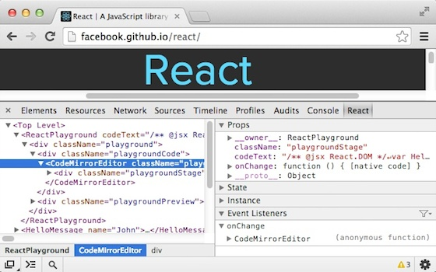
React Developer Tools

Slide 9

Introduction to webpack

Slide 10
Setting up webpack and cool features like HMR :)

